Slide 1
CLASSROOM RULES
Be on time
Be interactive
100% or nothing
Do all daily challenges

Slide 2

Lesson 18:
SENTENCES
Brought to you by LangGo

Slide 3
REVIEW: GRAMMAR + VOCABULARY

Slide 4
REVIEW: LISTENING
How do you like where you’re living?
What’s your city like?
The good thing is there are a lot of things to do here.
The trouble is it’s getting very polluted.
The city has a very nice climate. It’s never too hot or too cold.
It's very noisy and crowded.
The air is fresh and the people are very friendly.

Slide 5
REVIEW: LISTENING
8. It's close to the sea, so it’s great in the summer.
9. The subway system is pretty good, too, but it’s very old and not very clean.
10. One thing I do like is that there’s very little noise.
11. It's awfully crowded and the air is so dirty.
12. It's really a great city, but you have to pay a fortune for everything.
13. It’s pretty and quiet and it isn’t dangerous at all.
14. It has a lot of lovely old buildings and great restaurants
15. It’s easy to get around and everything is very clean.

Slide 6
REVIEW: SPEAKING
1. Where do you come from?
2. What do you like about your hometown?
3. Is there anything you dislike about your hometown?
4. Are there any lakes or rivers/woods or forests/hills or mountains in your hometown?

Slide 7
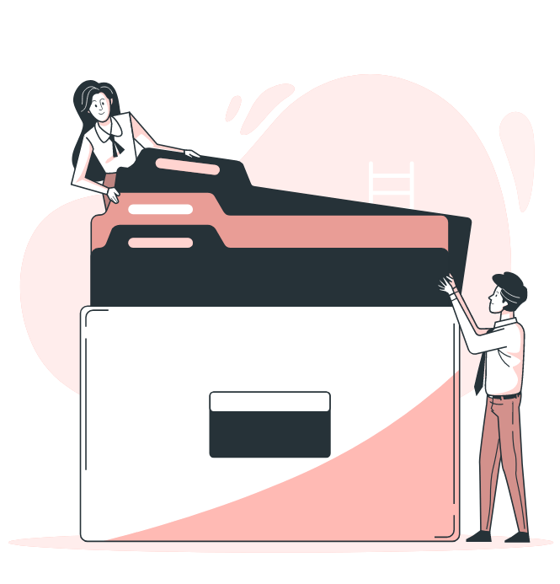
Objectives
01
03
Identify the components and their function of common sentences
02
Make basic compound sentences with coordinating conjunctions
Practice: Asking and answering Speaking questions

Slide 8
DEFINITION
SUBJECT | VERB | OBJECT
 | Listen.
 | Open | the book.
Maggie | is reading | a book.
It | is raining.
Câu diễn đạt 1 ý hoàn chỉnh.
Câu bắt buộc phải có chủ ngữ và động từ (hoặc chỉ có động từ - câu mệnh lệnh), tân ngữ có thể có hoặc không.
Luôn viết hoa chữ cái đầu tiên của câu, và kết thúc câu bằng dấu “.”.

Slide 9
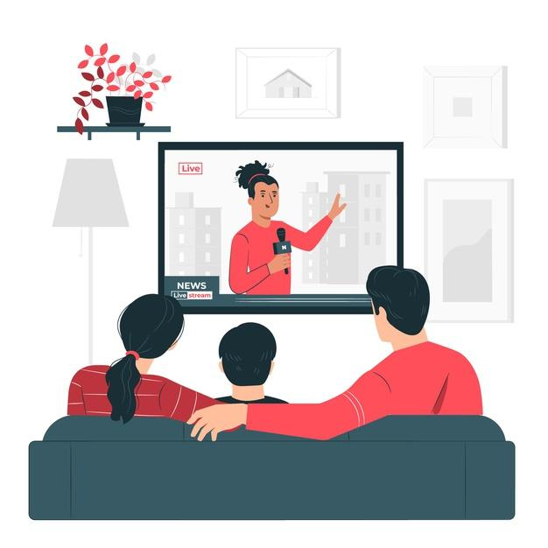
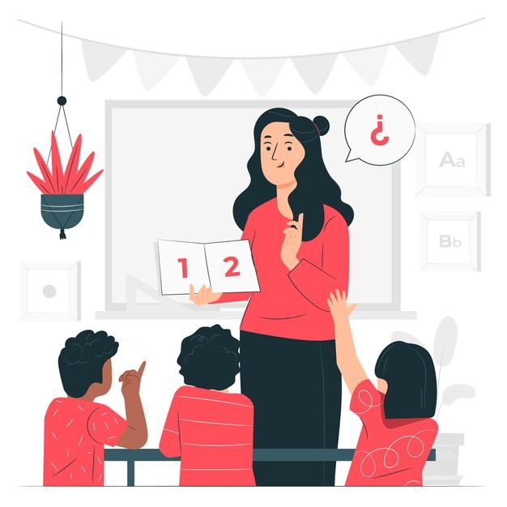
Subject: Ai/cái gì làm? (Người thực hiện)
Object: Ai/cái gì bị tác động bởi hành động đó? (Người/vật nhận tác động)
SUBJECT - OBJECT
They watch the news.
She teaches children.
S
O
S
O

Slide 10
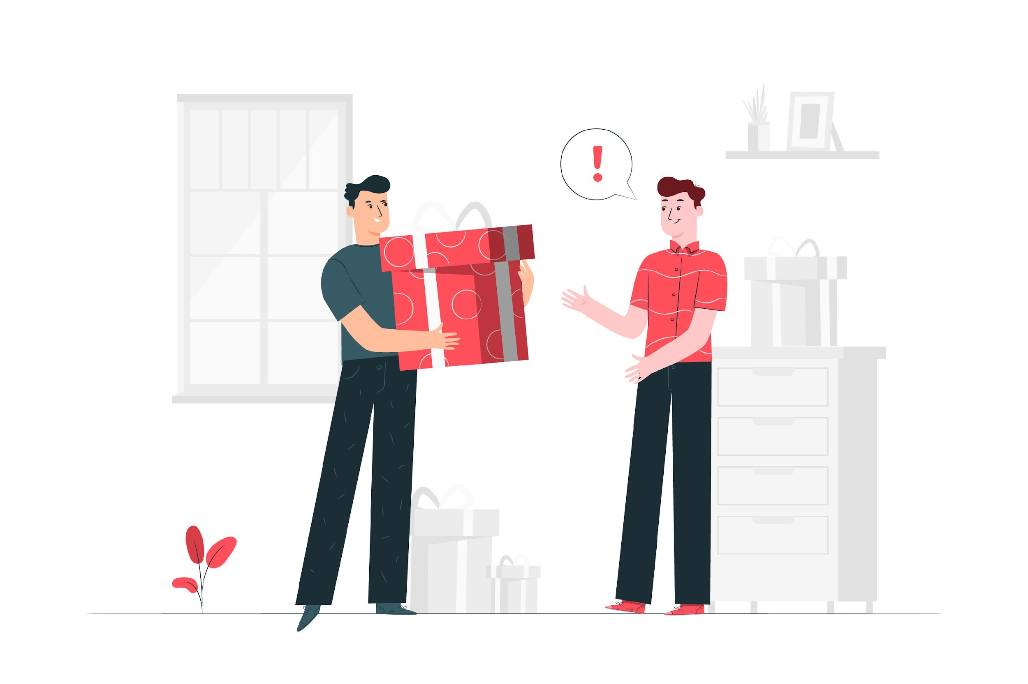
Direct object: trực tiếp nhận hành động, trả lời câu hỏi “Cái gì?”
Indirect object: người/ vật nhận kết quả của hành động, trả lời câu hỏi “Cho ai?”,
“Cho cái gì"
DIRECT & INDIRECT OBJECTS
direct object
indirect object
Ethan gave John a present.

Slide 11
Underline the direct object and circle around the indirect object in these sentences.
1. He buys some cough medicine for me.
2. We wear warm clothes.
3. Will buys healthy food for his dog.
4. This medicine makes me feel sleepy.
5. The doctor gives Anne some aspirin.
6. She eats some fruits for dessert.
7. She cooks some healthy food for her friend.
8. My sister became a doctor.
=> “a doctor" không nhận hành động từ “became" => không phải tân ngữ

Slide 12
Complement
Complement (Bổ ngữ) là từ/cụm từ mô tả hoặc định danh cho một thứ khác trong câu, không phải nhận hành động.
Subject Complement (S + V + C): Đứng sau động từ "to be" hoặc động từ nối (feel, look, seem...), nó mô tả Chủ ngữ.
  Ex: She is happy. ("happy" mô tả "She")
  Ex: He became a teacher. ("a teacher" định danh "He")
2. Object Complement (S + V + O + C): Đứng sau Tân ngữ, nó mô tả Tân ngữ.
  Ex: They made me angry. ("angry" mô tả "me")
  Ex: We called him John. ("John" định danh "him")

Slide 13

WH- question:
Structure: WH (+ Aux V) + S + V (+O)?
Example: Who are they?
INTERROGATIVE SENTENCE
Yes/No question:
Structure: Aux V + S + V (+ 0)? Example: Are they students?
Trợ động từ (be, have, do) đảo lên trước Chủ ngữ trong câu hỏi
Chia trợ động từ theo đúng thì và chủ ngữ trong câu.

Slide 14

INTERROGATIVE SENTENCES
What/ you/ like/ about/ your hometown?
What time/ your mother/ get up?
What kinds of clothes/ your father/ often/ wear?
When/ you/ go? (talking about your last trip)
Where/ you/ prefer/ watch movies?
Which room/ you/ spend/ most of your time/ in?
Why/ you/ enjoy/ playing sports?
How often/ you/ eat out?
How/ your father/ go to work?

Slide 15
INTERROGATIVE SENTENCES
What do you like about your hometown?
What time does your mother get up?
What kinds of clothes does your father often wear?
When did you go? (talking about your last trip)
Where do you prefer to watch movies?
Which room do you spend most of your time in?
Why do you enjoy playing sports?
How often do you eat out?
How does your father go to work?
If the WH- question word is the subject of the question, it comes before the verb.
Who told you that?
What makes you change your mind?

Slide 16
COMPOUND SENTENCES
I want the sporty red car, but I will buy the blue one.
S₁
V₁
O₁
S₂
V₂
S₂
Coordinating conjunction
Câu ghép gồm ít nhất 2 mệnh đề (mỗi mệnh đề có thể đứng riêng thành 1 câu đơn).
Các mệnh đề trong câu ghép được liên kết với nhau bằng các coordinating conjunctions (FANBOYS: for, and, nor, but, or, yet, so).

Slide 17
What do you like about your hometown?
I like the food here, and the people are nice.
What time does your mother get up?
My mother gets up early, for she needs time to make breakfast.
What kinds of clothes does your father often wear?
My father often wears shirts and pants, but sometimes he wears shorts at home.
When did you go?
I went on my last trip in summer, so it was very hot.
Where do you prefer to watch movies?
I like to watch movies at home, for I can eat snacks, and I can be comfortable.

Slide 18
6. Which room do you spend most of your time in?
I spend most time in my bedroom, and I often read books there, yet sometimes I play games in the living room.
7. Why do you enjoy playing sports?
I enjoy sports because it keeps me healthy, and it's fun with friends.
8. How often do you eat out?
I eat out once a month, but I prefer to cook at home.
9. How does your father go to work?
My father goes to work by motorbike, for it's fast, and it's easy to park.

Slide 19
PRACTICE: Hỏi đáp phản xạ và sử dụng câu ghép trong tất cả các câu trả lời
What do you like and dislike about your hometown?
What time does your mother get up?
What kinds of clothes does your father often wear?
When did you go?
Where do you prefer to watch movies/ read books/ hang out with your friends?
Which room do you spend most of your time in?
Why do you enjoy playing sports/ listening to music?
How often do you eat out?
How does your father go to work?

Slide 20
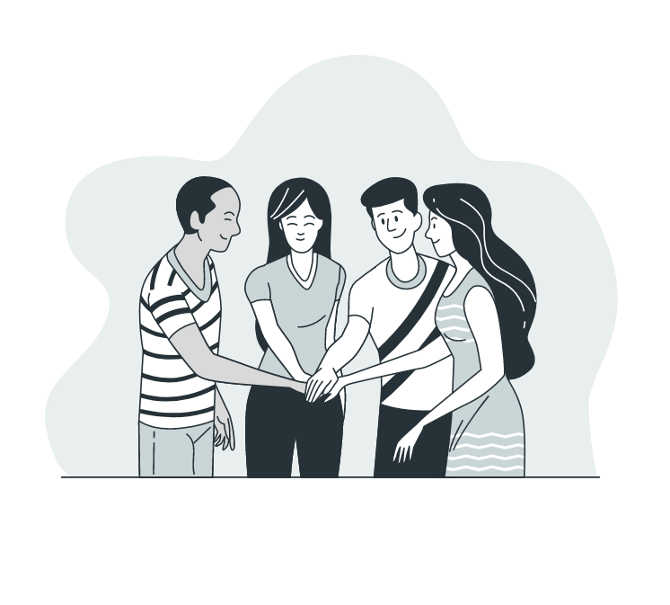

Thanks!
See you later!

